Slide 1
KEY INSIGHTS INTO SALES DATA
SolUTION 5

Slide 2
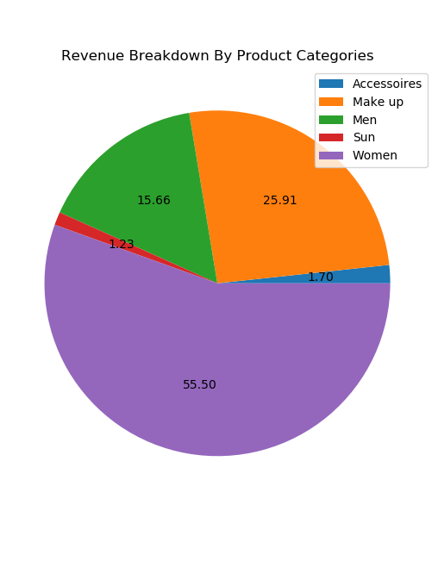
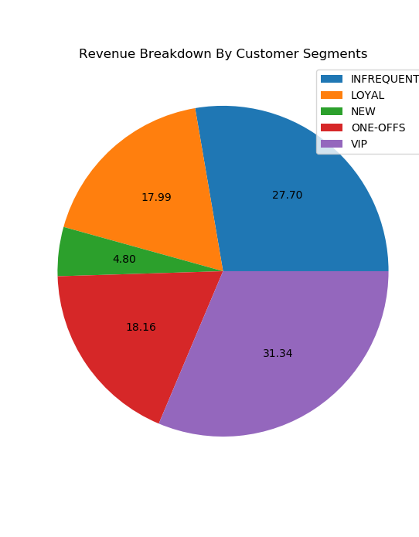
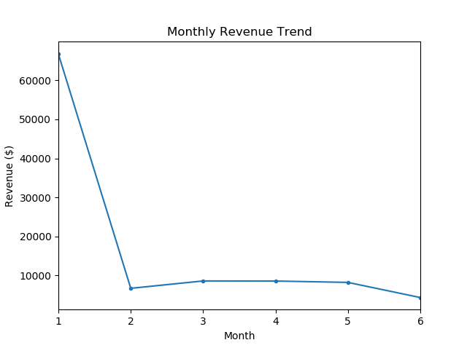
Overall Revenue Trends
Revenue is highest in the month of January and a steep decrease in revenue is seen in the other months within the analyzed period
Revenue is relatively constant in the past 5 months
More than 50% of revenue comes from Women categorized products, next being Make-up related products
Largest revenue comes from VIP segment customers (~31%) followed by Infrequent segment (~27%)

Slide 3
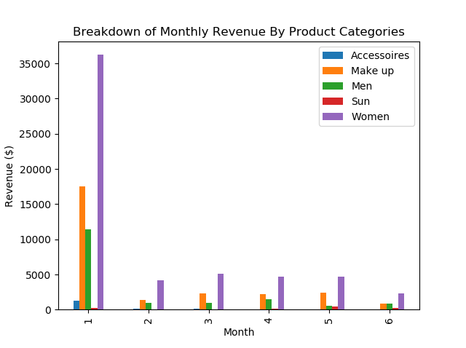
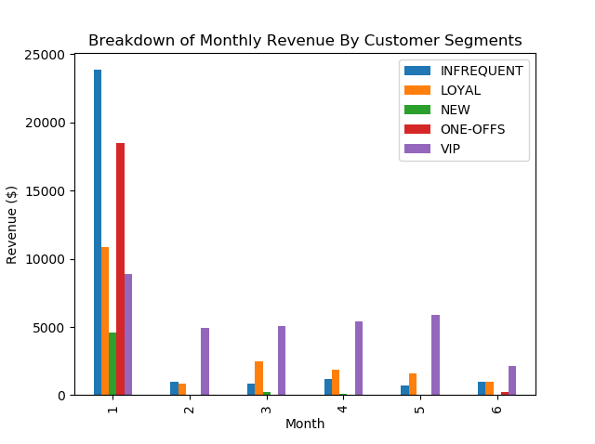
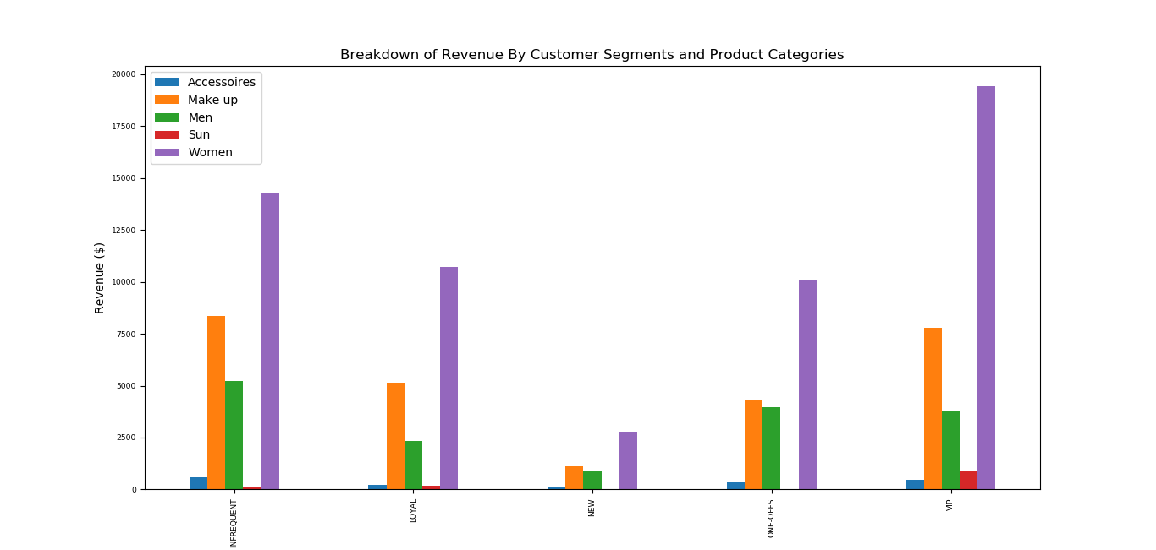
In-depth Analysis of Customer Segments & Product Categories
Product Categories trends are mostly constant throughout the month where highest grosser is women category, followed by Makeup and Men respectively
In Customer Segments, significant revenue is received from Infrequent and One-offs customers in the first month which is larger than highest customer segment grosser in the rest of the months; VIP customers have relatively constant contribution throughout those months.
The revenue trends are similar to monthly revenue trends for product categories for each customer segment

Slide 4
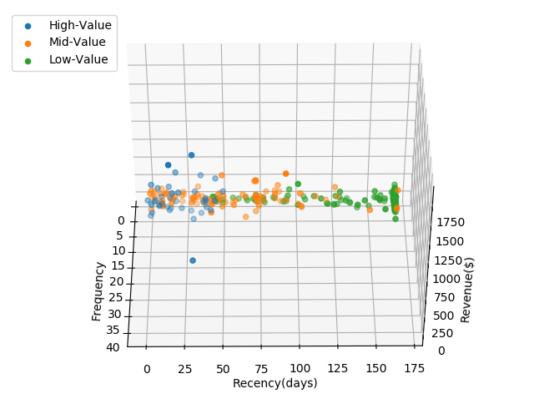
Methodology of Recency, Frequency & Monetary Analysis (RFM Analysis)
Evaluated Recency, Frequency and the total amount of revenue spent by each customer
Using K-Means Clustering, RFM data are clustered and assigned cluster value.
Recency clusters are ordered in descending order where larger values clusters are assigned lower cluster value
Frequency and Revenue clusters are ordered in ascending order where lower values clusters are assigned lower cluster value
Optimal no of clusters are found to be 4 using Elbow Method that uses sum of squared distance
Cluster Values are added to evaluate each customer’s overall RFM score (OV)
OV are categorized into High(OV>5), Medium(2<OV≤5) and Low values (OV ≤2)
Please refer to RFM Analysis.ipynb for more information and models

Slide 5
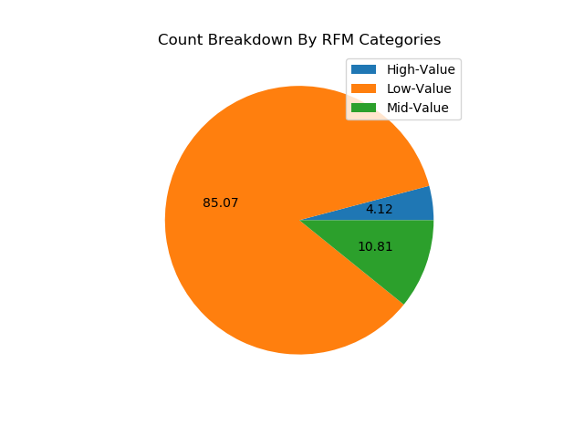
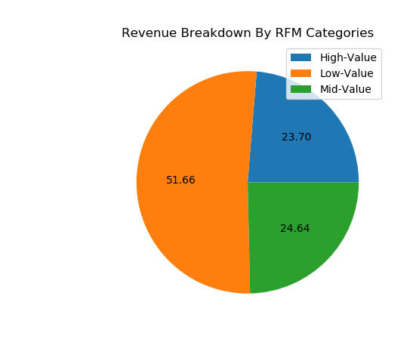
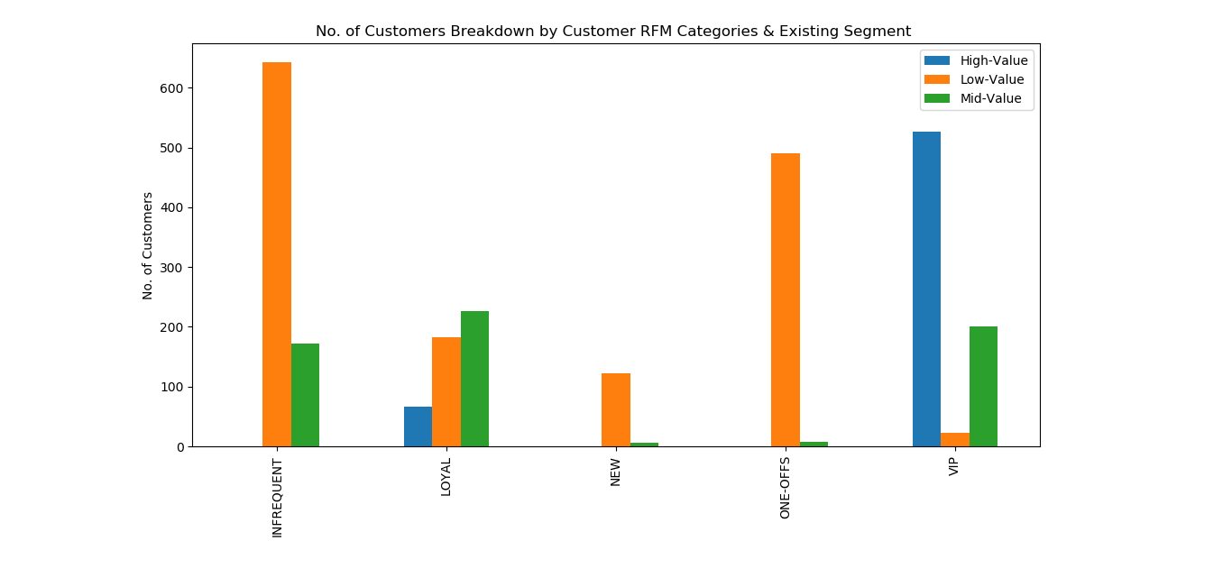
In-Depth RFM Analysis
Low Value customers have the largest number of counts & contributions to revenue, followed by Medium and High Value respectively
Surprisingly, more low value customers are found in loyal customers than high value customers
Large number of high value customers are found in VIP segment
One-offs and Infrequent segments have high number of low-value customers

Slide 6
Key Insights & Recommendations
Low Customer Retention from first month to rest of the months
Infrequent and One-offs customers contributions were much higher in first month and couldn’t be reflected in other months
Feedback from such customers will allow to get more insight into why they aren’t shopping more
Relatively lower number of high value customers and large numbers of low value customers
High value customers are ideal customers for a retail company and its important for a retail company to show them the appreciation for their business. Some of the techniques to increase their engagement with the products could be through loyalty programs, inviting them to special events, giving them exclusive access to new product testing in women and makeup sections .
Medium value customers provide decent amount of business as well and should be encouraged to be in high value customers. This could be done by giving them customized discounts & special deals on products in high demand products such as in women and makeup section
Low value customers are least active ones out of all. Since most of the customers in this retail shop are low value they shouldn’t be neglected at all. In fact, they should be allowed to give feedbacks on the products as well as encouraged periodically say, monthly to shop by special deals & discounts. Much of the marketing & advertising techniques should be targeted to this group to make them realize the benefits of the company’s products.

